Slide 1



Slide 2

FoodByte: A Grocery Shopping App and Website
Supervised by:
Mam Tahira Sadaf
Group Members:
Muhammad Bilal (FA17-BCS-014)
Muhammad Afshal (FA17-BCS-029)
Department of Computer Science
COMSATS University Islamabad, Attock Campus

Slide 3
Outline
Introduction
Problem statement
Goals and Objectives
Functional/Non-Functional Requirements
Methodology
Tool and Techniques
Benefits
Project Design
User Interface
References
_______________________________

Slide 4

Introduction
FoodByte is a grocery shopping android app and web (Portal) App where user can buy grocery items online. Grocery items are displayed in effective graphical user interface. This system will be like a virtual supermarket. Marts will register themselves on our app and their products will be displayed in well graphical way. The purpose of this system is to give benefit and ease to user by saving their precious time. Through this app and website user will be able to get all grocery items on their door step without going to supermarket with carrying heavy bags and waiting in queue outside the shop for your turn. Secondly it will give an opportunity of earning for those riders who will go to supermarket instead of you and also it will be an advertisement platform for the marts that will register themselves on our app. nearest rider to the picking point, will be allocated to the user automatically. Admin will handle the system where he can add or remove items and riders. User will create a list of items in the cart and this will be shared among both user and rider.
_______________________________

Slide 5
Problem Statement
Food Byte grocery system to provide a facility to do grocery without going to supermarket, by providing the facility of creating grocery lists, assigning the riders, tracking riders and updating the grocery lists in order to provide services at user’s door step.
_______________________________

Slide 6
Goals and Objectives
Providing rider service.
Earning Opportunity.
Order made to the registered shopkeepers.
Registered shops can be accessed only.
Machine learning Algorithm for Content Based
recommendations.
_______________________________

Slide 7
Functional Requirements
Requirements are important part of software development. Before starting a project, requirements are gathered, to formulate and manage the designing phase.
Initially user will be registered in this app.
System will automatically get the riders location.
Allow user to choose nearest Mart.
System maintains the database of the Customers.
_______________________________

Slide 8
Non-Functional Requirements
Non-Functional requirement defines a function and its components.
Performance
The system will be able to perform all the tasks efficiently. All the features which we introduced in this app are performing all the functionality properly.
Availability
Users can access the system anytime, anywhere.
Response time
The system will be able to respond in few seconds. It is easy to install and take just few seconds to install if your internet availability is much better.
_______________________________

Slide 9
Methodology
As there is no such facility for the Customers that provides nearest Mart and Rider according to Location therefore, we will develop this android based app in which, when User logins or registers, They will choose any Mart which is near to their location and where all the desired items are available. Customer will make a List of items, which customer wants to buy. Customer will select the nearest rider, the Item list will be shared with the rider and Mart. Rider will buy these items and deliver these items to customers on their doorstep. Also Customer will pay rider on doorstep.
_______________________________

Slide 10
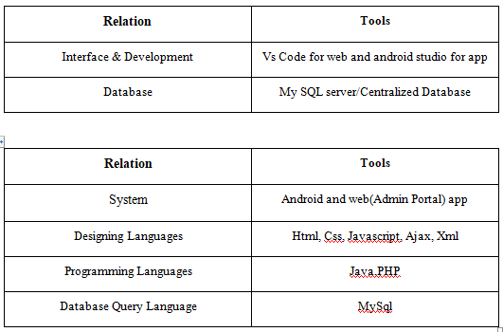
Tool and Techniques
_______________________________

Slide 11
Benefits
Time Saving.
Providing earning opportunity for rider.
Ease to find products and ordering.
Nearest riders will be shown to user for urgent need.
_______________________________

Slide 12
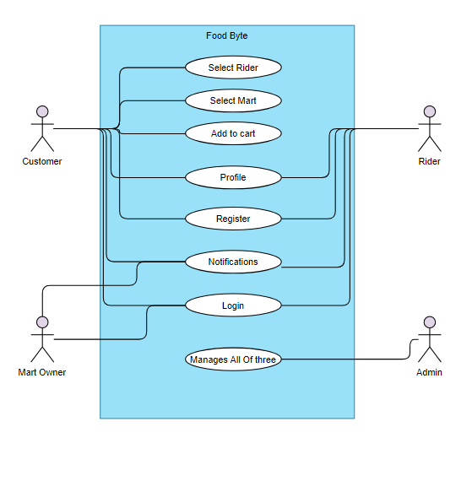
Project Design
Use Case Diagram

Slide 13
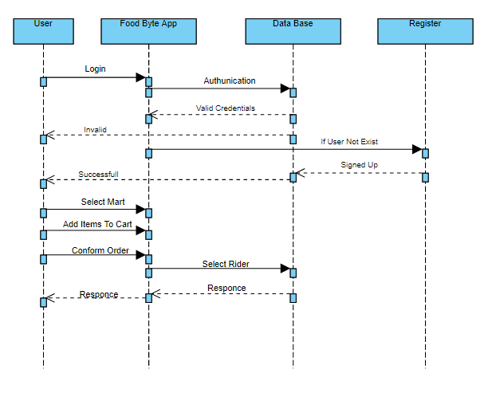
Project Design
Sequence Diagram of User:

Slide 14
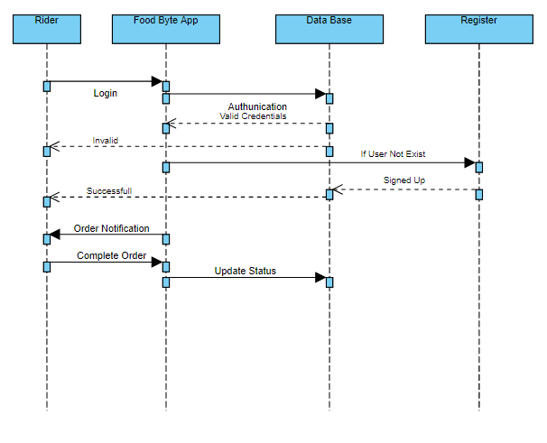
Project Design
Sequence Diagram of Rider:

Slide 15
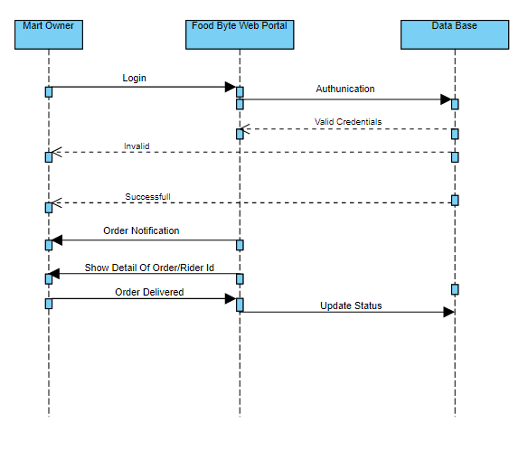
Project Design
Sequence Diagram of Mart:

Slide 16
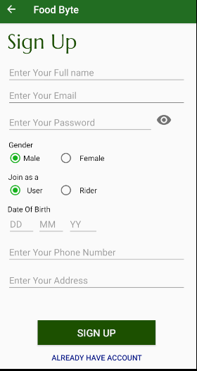
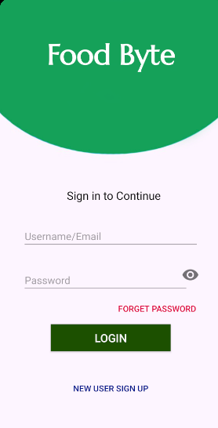
User Interface
Login/Register

Slide 17
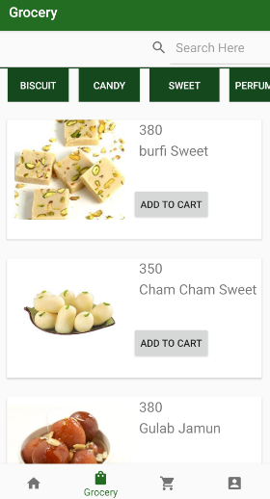
User Interface
Home Page

Slide 18
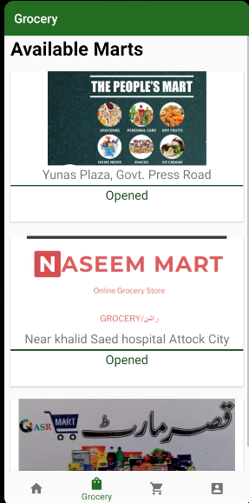
User Interface
Marts Available

Slide 19
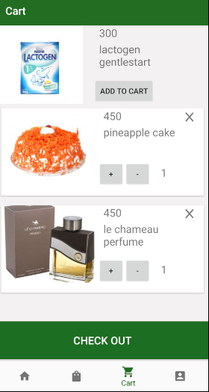
User Interface
Cart Menu

Slide 20
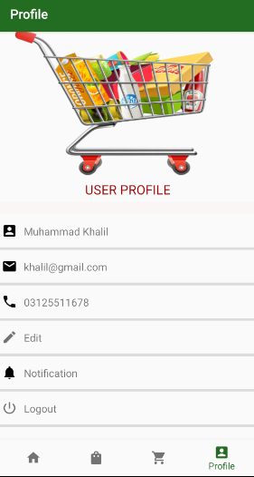
User Interface
User Profile

Slide 21
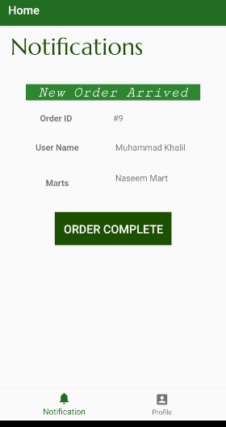
Rider Notifications

Slide 22
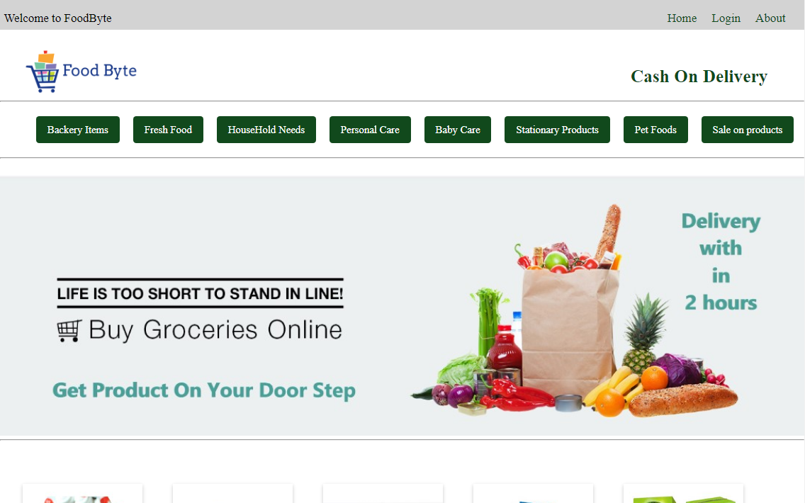
Admin Interface
Website Home Page

Slide 23
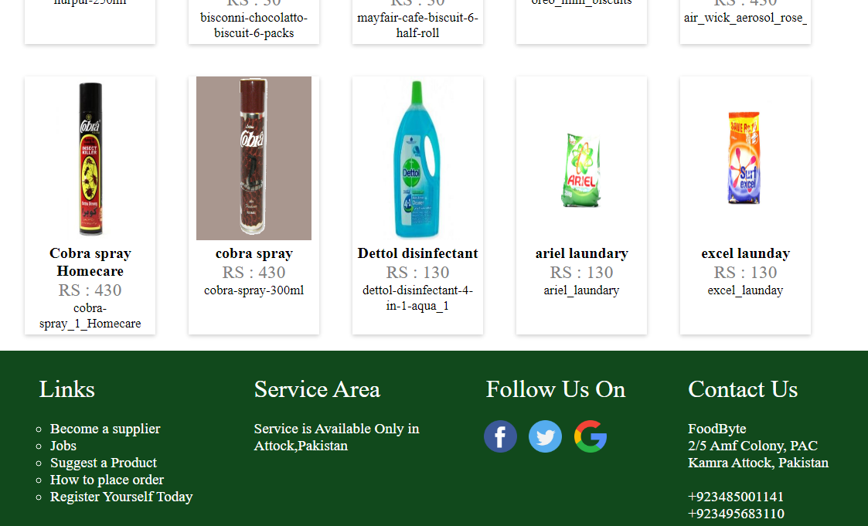
Admin Interface
Website Home Page

Slide 24
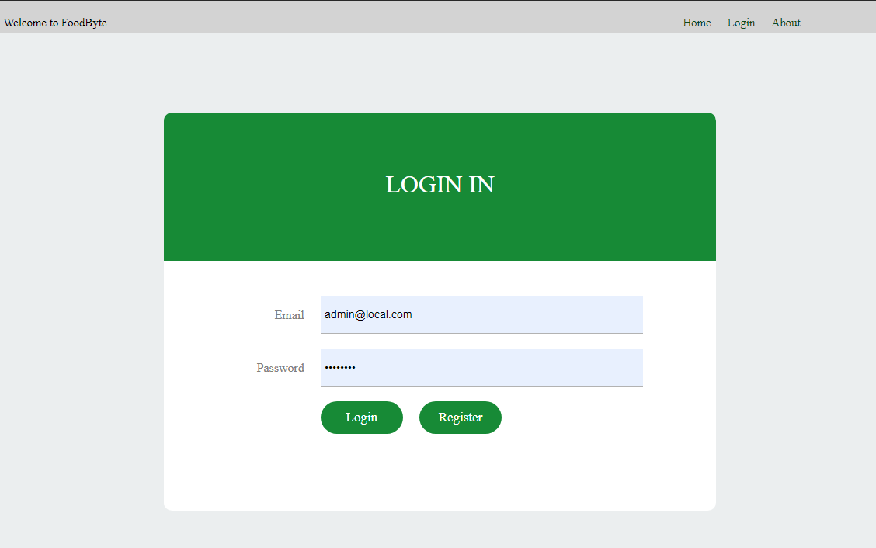
Admin/Mart Interface
Login

Slide 25
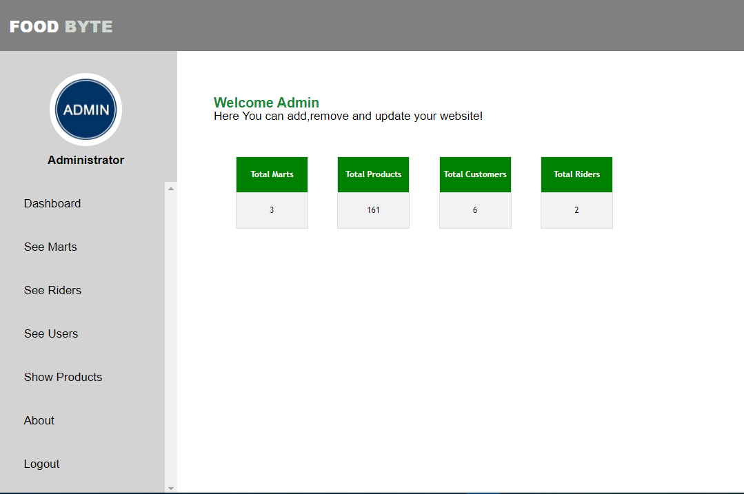
Admin Interface
Dashboard of admin

Slide 26
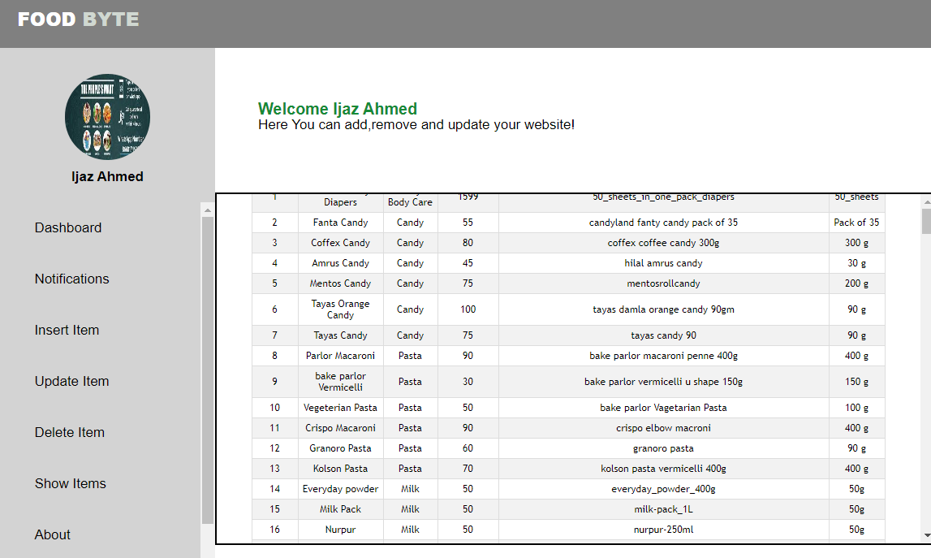
Marts Interface
Dashboard Of Mart owner

Slide 27
Thank You

